Slide 1
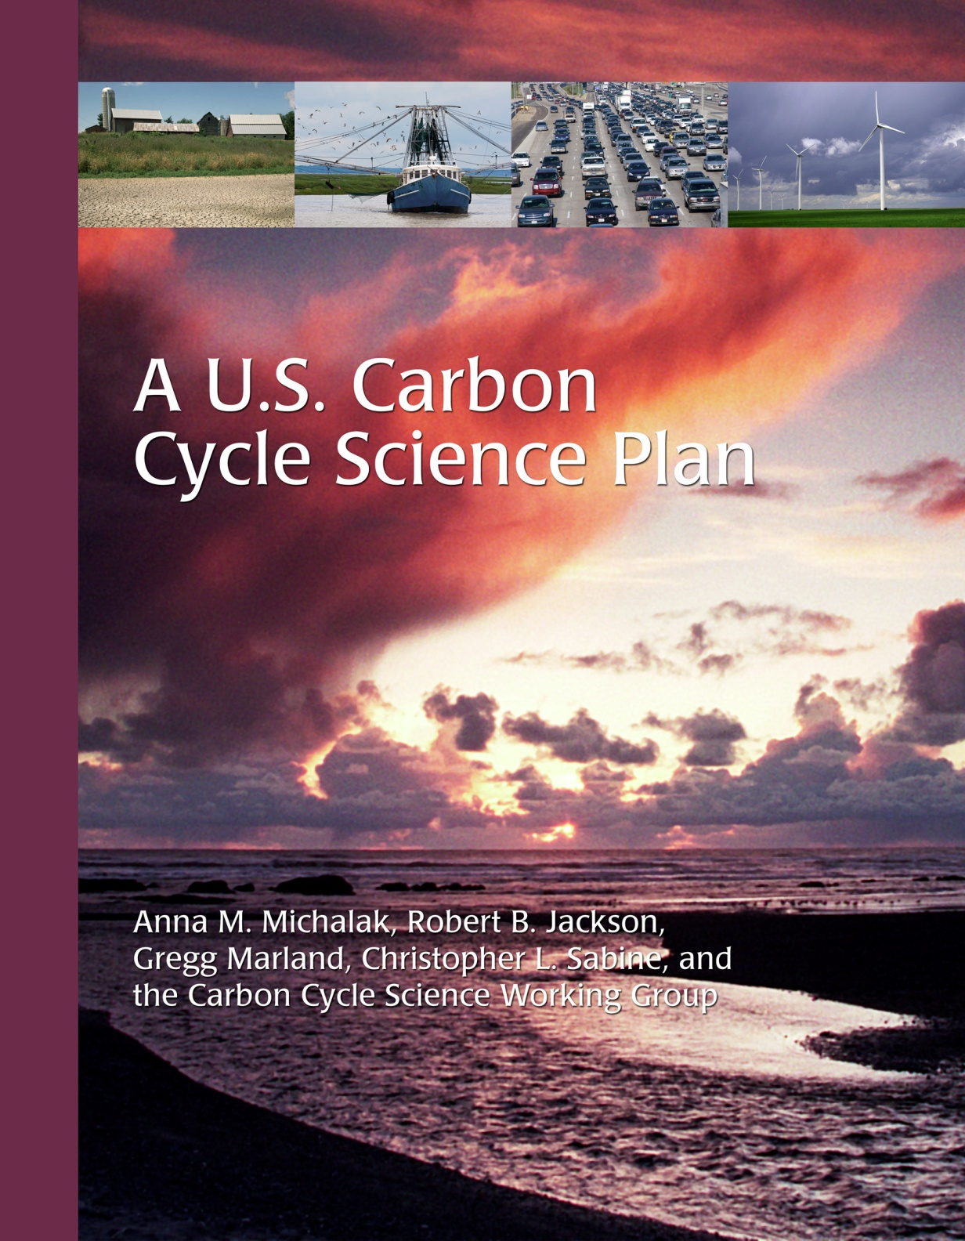
A Brief Review of the New U.S. Carbon Cycle Science Plan

Slide 2
Working Group Membership
Rob Jackson – Co-lead (Duke U.) | Lisa Dilling (U. Colorado) | Brian O’Neill (NCAR)
Gregg Marland – Co-lead (ORNL) | Andy Jacobson (NOAA / U. Colorado) | Steve Pacala (Princeton)
Anna Michalak – Co-lead (U. Michigan) | Matthew Kahn (UCLA) | Jim Randerson (UC Irvine)
Chris Sabine – Co-lead (PMEL) | Steve Lohrenz (U. Southern Mississippi) | Steve Running (U. Montana)
Bob Anderson (Columbia U.) | David McGuire (U. Alaska) | Brent Sohngen (Ohio State U.)
Deborah Bronk (Col. of William & Mary) | Galen McKinley (U. Wisconsin) | Pieter Tans (NOAA-ESRL)
Ken Davis (Penn State) | Charles Miller (JPL) | Peter Thornton (ORNL)
Ruth DeFries (Columbia U.) | Berrien Moore (Climate Central) | Steve Wofsy (Harvard)
Scott Denning (Colorado State U.) | Dennis Ojima (Heinz Center) | Ning Zeng (U. Maryland)

Slide 3
Fundamental Science Questions
1999 U.S. Carbon Cycle Science Plan:
What has happened to the carbon dioxide that has already been emitted by human activities (past anthropogenic CO₂)?
What will be the future atmospheric CO₂ concentration trajectory resulting from both past and future emissions?
A New Carbon Cycle Science Plan
How do natural processes and human actions affect the carbon cycle, on land, in the atmosphere, and in the oceans?
How do policy and management decisions affect the levels of atmospheric carbon dioxide and methane?
How are ecosystems, species, and resources impacted by increasing greenhouse gas concentrations, the associated changes in climate, and carbon management decisions?

Slide 4
Overall Directions
Many research priorities identified in the 1999 Plan remain important
However, new priorities for carbon cycle research are also needed, including:
Effects of human activities on carbon cycling,
Vulnerability and resilience of ecosystems to changes in carbon cycling and associated changes in climate
Efficacy and environmental consequences of carbon management policies, strategies, and technologies
Additional emphasis is also needed to:
Evaluate uncertainties in our understanding of the global carbon cycle
Coordinate researchers across scientific disciplines

Slide 5
Fundamental Science Questions
1999 U.S. Carbon Cycle Science Plan:
What has happened to the carbon dioxide that has already been emitted by human activities (past anthropogenic CO₂)?
What will be the future atmospheric CO₂ concentration trajectory resulting from both past and future emissions?
A New Carbon Cycle Science Plan:
How do natural processes and human actions affect the carbon cycle, on land, in the atmosphere, and in the oceans?
How do policy and management decisions affect the levels of the primary carbon-containing gases, carbon dioxide and methane, in the atmosphere?
How are ecosystems, species, and natural resources impacted by increasing greenhouse gas concentrations, the associated changes in climate, and by carbon management decisions?

Slide 6
Goals
Provide clear and timely explanation of past and current variations observed in atmospheric CO₂ and CH₄ - and the uncertainties surrounding them. (Q1, Q2)
Understand and quantify the socio-economic drivers of carbon emissions, and develop transparent methods to monitor and verify those emissions (Q1, Q2).
Determine and evaluate the vulnerability of carbon stocks and flows to future climate change and human activities, emphasizing potential positive feedbacks to sources or sinks that make climate stabilization more critical or more difficult. (Q1, Q2, Q3)

Slide 7
Goals (cont’d)
Predict how ecosystems, biodiversity, and natural resources will change under different CO₂ and climate change scenarios. (Q3)
Determine the likelihood of success and the potential for unintended consequences of carbon-management pathways that might be undertaken to achieve a low carbon future. (Q1, Q2, Q3)
Address decision-maker needs for current and future carbon-cycle information and provide data and projections that are relevant, credible, and legitimate for their decisions. (Q1, Q2, Q3)

Slide 8
Goal 1
Provide clear and timely explanation of past and current variations observed in atmospheric CO₂ and CH₄ - and the uncertainties surrounding them. (Q1, Q2)
To address this goal, we need to develop the capability to estimate variability in carbon sources and sinks, as well as the processes controlling that variability. This goal also provides a link to the human dimensions of the carbon cycle, because understanding the economic and policy links to anthropogenic emissions and sequestration efforts is essential for understanding variations in atmospheric CO₂ and CH₄.

Slide 9
Goal 2
Understand and quantify the socio-economic drivers of carbon emissions, and develop transparent methods to monitor and verify those emissions (Q1, Q2).
This goal seeks to understand the fundamental human processes that drive carbon emissions. It also provides a framework for developing quantitative tools for verifying the magnitude of emissions and determining the effects of mitigation and sequestration activities using “bottom up” and “top down” approaches. The developed approaches must be transparent and relevant to policy-makers.

Slide 10
Goal 3
Determine and evaluate the carbon stocks and flows that are most vulnerable to climate change and land–use change, emphasizing potential positive feedbacks to sources or sinks that make climate stabilization more critical or more difficult. (Q1, Q2, Q3)
All carbon reservoirs and carbon processes are not equally vulnerable to change, resilient to stress, responsive to management, and susceptible to unintended consequences of management decisions. We need to be able to identify the signs of change, the symptoms of trouble, and the opportunities for managing the natural and anthropogenic components of the global carbon cycle.

Slide 11
Goal 4
Predict how ecosystems, biodiversity, and natural resources will change under different CO₂ and climate change scenarios. (Q3)
Even in the absence of climate change, rising atmospheric CO₂ alters ecological factors such as the chemistry of surface waters and the biodiversity of terrestrial ecosystems. For instance, changes in water chemistry have been shown to have important but still poorly understood consequences for coral reefs and other marine organisms with carbonate shells. This goal assesses the impacts of increased atmospheric CO₂ on ecosystem form and function.

Slide 12
Goal 5
Determine the likelihood of success and the potential for unintended consequences of carbon-management pathways that might be undertaken to achieve a low carbon future. (Q1, Q2, Q3)
The global carbon cycle is complex and closely linked to the energy, water, and nutrient cycles on Earth as well as to demographic and economic systems globally. Ethical and equity issues are central to what actions might be taken, who takes them, and what consequences result. This goal aims to understand interlinked natural and managed systems well enough for individuals, corporations, and governments to be able to make rational and well-informed decisions on how to best reduce their environmental footprint.

Slide 13
Goal 6
Address decision-maker needs for current and future carbon-cycle information and provide data and projections that are relevant, credible, and legitimate for their decisions. (Q1, Q2, Q3)
Useful science involves both asking the right questions and making the results available in a useful way. A goal of carbon cycle research is to interact with decision makers in an on-going dialogue so that socially relevant questions are addressed and that research results are accessible where and when needed. Decision makers need sound understanding of what is happening now and sound projections of what can be expected in the future. We also recognize for the importance of curiosity-driven research that anticipates the needs and basic understanding behind questions not yet asked by decision makers.

Slide 14
Critical Role of Observations
Establish baseline data sets and sustained observation systems for key carbon system variables and develop new long-term records to detect change.
In support of all of the other goals, we need an optimally designed and integrated long-term system of sustained observations of essential atmospheric, oceanic, biologic, demographic, and socioeconomic data to establish baselines, evaluate change, understand processes, and monitor mitigation actions. With this goal comes a commitment to data management and rapid data access.

Slide 15
Primary Program Elements
 | Program Elements
Goals | Sustained observations | Process studies and experiments | Modeling, prediction, synthesis | Communication dissemination
Explain observed variations | X | X | X | X
Quantify anthropogenic emissions | X | X | X | X
Evaluate vulnerable stocks and flows | X | X | X | X
Ecosystem impacts | X | X | X | X
Evaluate carbon management options | X | X | X | X
Decision support and information management | X | X | X | X

Slide 16
E1: Sustained Observations
Earth observing satellites for carbon and related parameters.
Integrated surface, tower, and aircraft sampling of atmospheric carbon and related species.
Coordinated global ocean carbon and ocean acidification observing networks.
Global networks of terrestrial inventories and fluxes, including soils and permafrost.
Monitoring and assessment of human systems, including mitigation and adaptation strategies and associated impacts.

Slide 17
E2: Global, Regional, Urban, & Ecosystem Scale Process Studies of System Dynamics & Function
Intensive process studies and field campaigns to understand natural and human systems and processes responsible for controlling carbon emissions, uptake, and storage as well as how they might change in the future.
Manipulative laboratory and field studies to elucidate the response of representative land and marine ecosystems to climate and biogeochemical change.
Field campaigns examining carbon cycling at a range of nested scales to test “bottom-up” and “top-down” approaches.

Slide 18
E3: Modeling, Prediction, Synthesis, Data Assimilation, and Uncertainty Quantification
Coupled physical and socio-economic components of existing climate system and integrated assessment models to produce first-generation integrated Earth System models.
Synthesis of observations, experimental results, and models to reduce uncertainty in model predictions and to increase model skill.
Model / data integration for optimally assimilating atmospheric observations and data about land, ocean, and fossil fuel fluxes, and coupling this information with atmospheric transport models to quantify and reduce uncertainty in carbon cycle estimates.

Slide 19
E4: Communication and Dissemination
Regular, two-way communication with the decision-making community and the general public, including seeking out critical public information needs.
Tools to translate results from scientific synthesis and prediction into quantitative, understandable products for policy and management professionals.
Approaches for communicating the level of certainty that scientists have in various components of the carbon budget to managers, decision-makers, and the general public.
Evaluation of the implications of uncertainty in present-day knowledge and in future carbon cycle projections for managers, decision makers, and the general public.
Regional analyses to determine how management options are being evaluated and how the carbon science community can help inform that process.

